Slide 1

Stock market shale
ok

Slide 2
Objective & Scope of the Study
Understand overall dataset structure
Identify key variables influencing outcomes
Detect patterns, trends, and anomalies
Define boundaries of analysis for clarity and focus

Slide 3
Analytics Approach
Data collection and understanding
Data cleaning and preprocessing
Exploratory Data Analysis (EDA)
Feature selection and transformation
Insights generation for decision-making

Slide 4
Tools and Techniques
Python: pandas, numpy, matplotlib, seaborn
Data cleaning: handling missing values, outliers
Visualization: histograms, scatterplots, correlation heatmaps
Statistical summary and distribution checks

Slide 5
Visualization (EDA)
Univariate analysis: distribution plots, box plots
Bivariate analysis: scatter plots, pair plots
Correlation matrix for relationships
Category-wise comparison bar and count plots

Slide 6
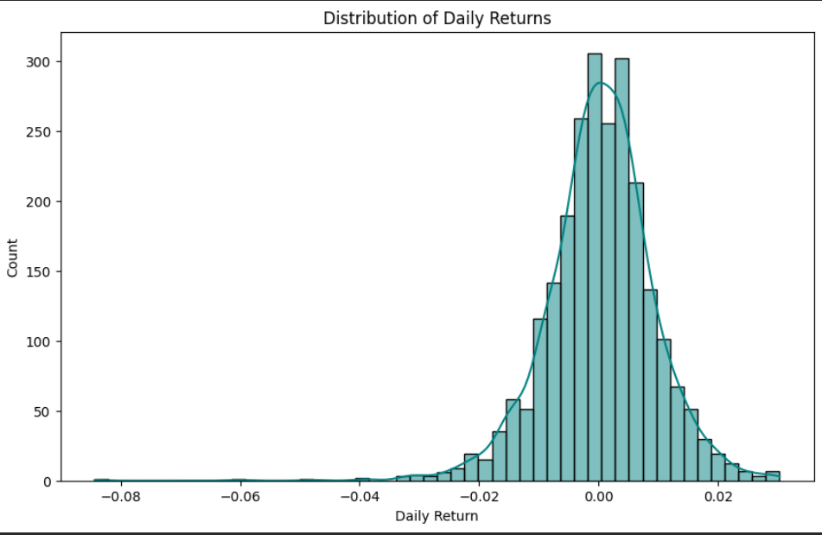
Distribution of daily returns
Shape: The distribution appears to be roughly bell-shaped, indicating a possible normal distribution.
Central Tendency: The peak of the distribution is centered around suggesting a mean daily return close to 0
Symmetry: The histogram seems fairly symmetric around the center
Spread: Daily returns range approximately from -0.04 to 0.02, indicating variability in returns.

Slide 7
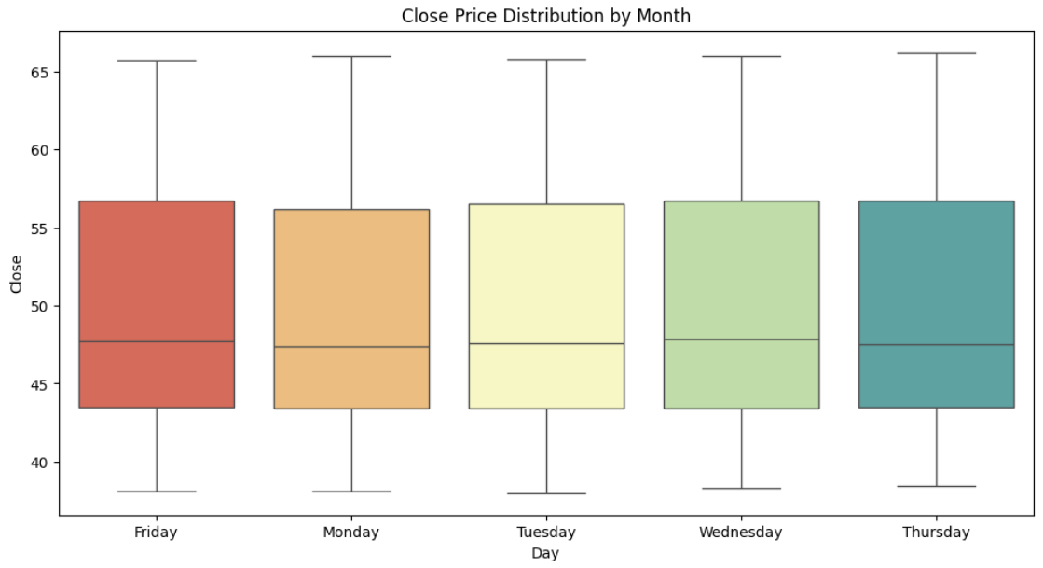
Close price Distributions by month
The graph appears to be a box plot showing Close Price Distribution by Month, but the days shown are actually weekdays (Friday to Thursday), not months
The box plot displays median close prices and variability for each weekday.
The days represented are Friday, Monday, Tuesday, Wednesday, and Thursday.

Slide 8
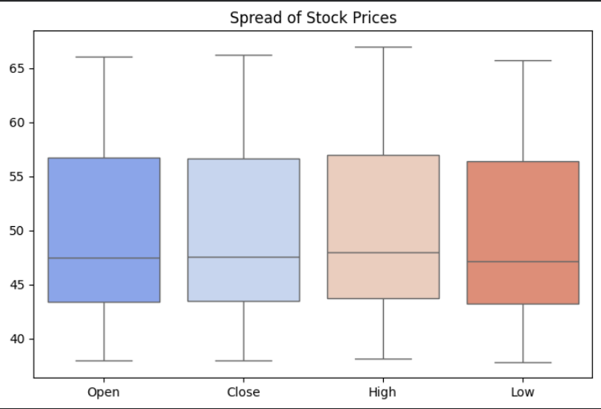
Spread of stock prices
Open: Median around 52-53, moderate spread, symmetrical distribution.
Close: Median slightly lower than Open, similar spread, possibly slightly skewed.
High: Median higher than Open/Close, wider spread, indicates higher volatility at peaks.
Low: Median lowest among the four, spread indicates variability in lows.

Slide 9
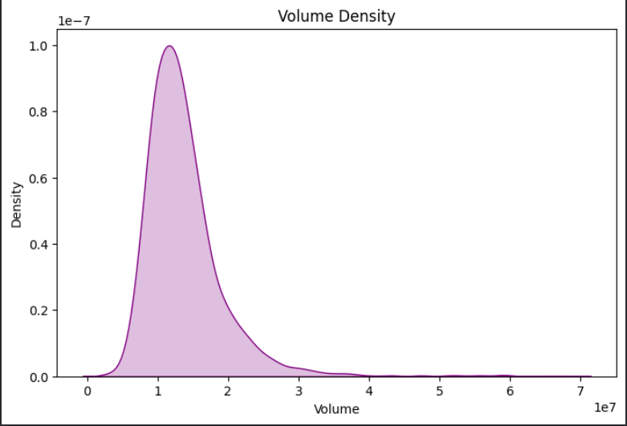
Volume density
The distribution is positively skewed (right-skewed).
Peak density is around a volume of 1e7.- Density approaches zero as volume increases beyond 3e7.
The x-axis represents volume, and the y-axis represents density.

Slide 10
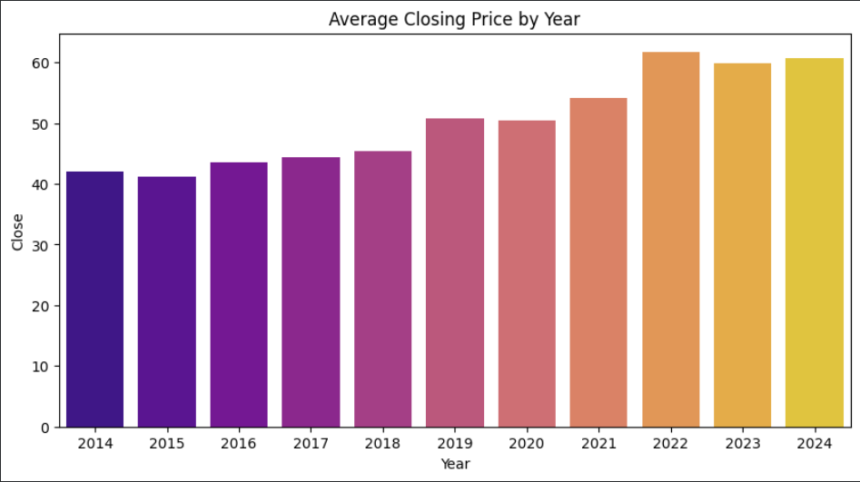
Average Closing price by year
The average closing price shows a steady increase from 2014 to 2024.
The price range appears to be between approximately 40 and 60 units, based on the y-axis
The graph indicates a consistent upward trend with no visible sharp declines or anomalies in the data from 2014 to 2024.

Slide 11
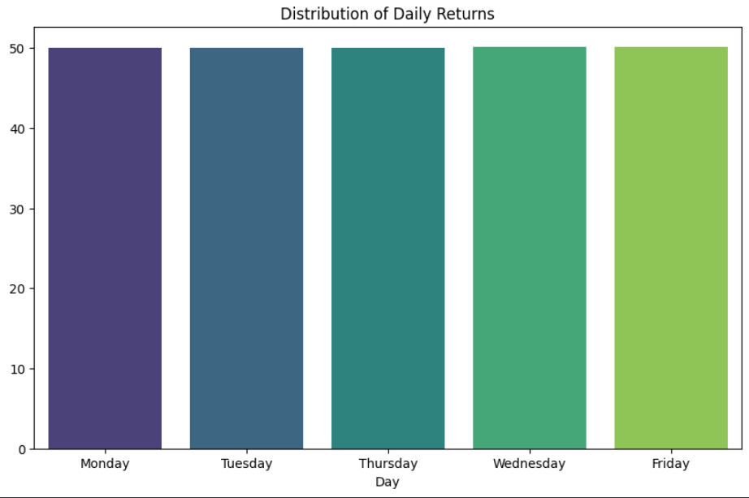
Distribution of daily Returns
The graph shows the Distribution of Daily Returns for a week (Monday to Friday)
The returns are relatively consistent across the days, with values around 50.
The exact values appear to be: Monday: approximately 50 Tuesday: approximately 50 Thursday: approximately 50 Wednesday: approximately 50 Friday: approximately 50
There is minimal variation in returns throughout the week.

Slide 12
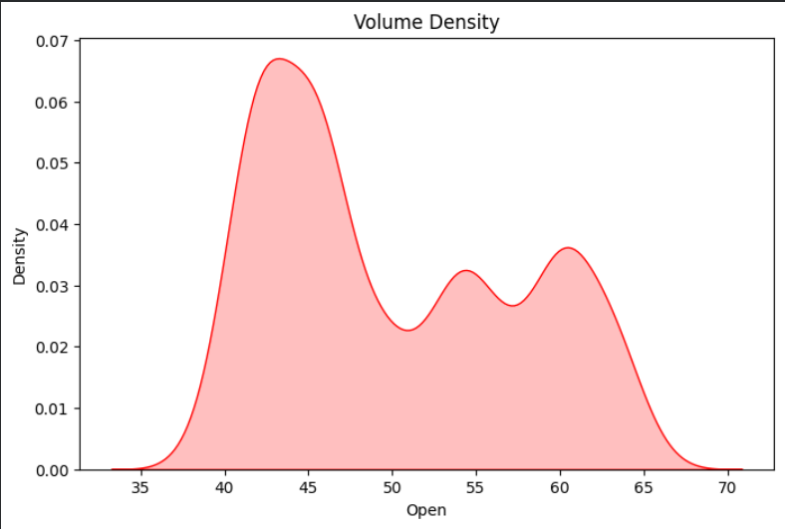
Volume density
The distribution is positively skewed (right-skewed)
Peak density is around a volume of 1e7.
Density approaches zero as volume increases beyond 3e7.
The x-axis represents volume, and the y-axis represents density.

Slide 13
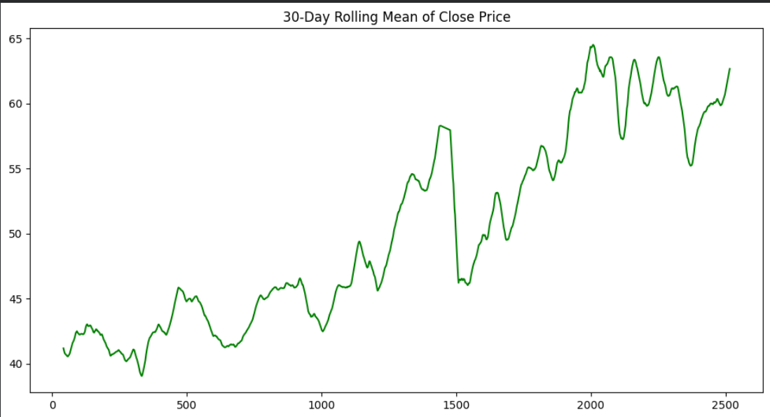
30-Day Rolling mean of class price
The graph shows a 30-Day Rolling Mean of Close Price, indicating a general upward trend over time with fluctuations.
The price appears to have increased from around 40 to above 60 over the period shown, with volatility evident in the jagged line.

Slide 14
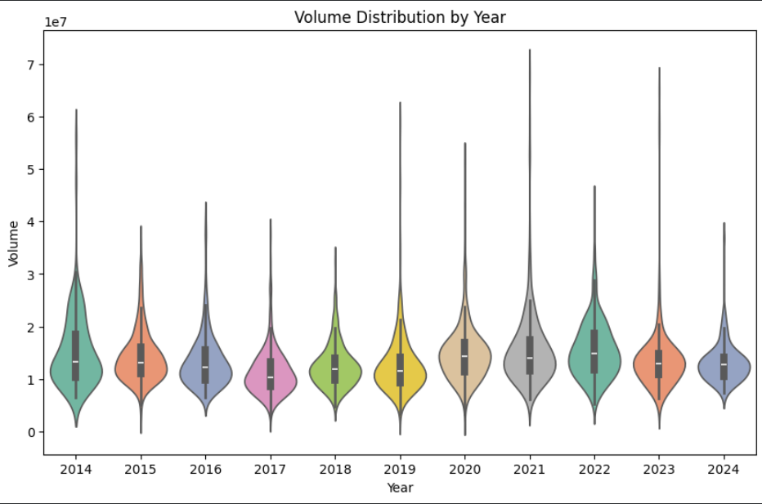
Volume Distribution by Year
The graph shows a volume distribution by year from 2014 to 2024, with each year represented by a violin plot displaying the distribution of volumes.
The plots indicate variability in volume across years, with some years showing higher median volumes and wider distributions than others.

Slide 15
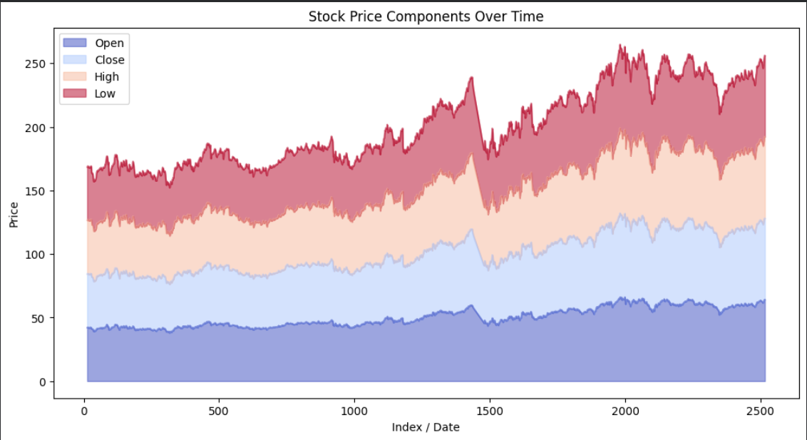
Stoke price components over time
The graph shows the stock price components over time, with four distinct price points: Open, Close, High, and Low.
The price range is depicted on the y-axis, spanning from 0 to 250, while the x-axis represents the index or date, ranging from 0 to 2500.

Slide 16
Thank you!!

